Slide 1
Presentation – 1 Training – BlockChain
Presented by:
Chirantan Ganguly
Sagnik Nayak

Slide 2
Topics
Basic idea behind symmetric key Cryptography
AES (symmetric key algorithm)
Basic idea behind asymmetric key Cryptography
RSA (asymmetric key algorithm)
Basic idea behind Hash function
SHA-256 (Hash function)
Basic idea of how digital signature is done

Slide 3
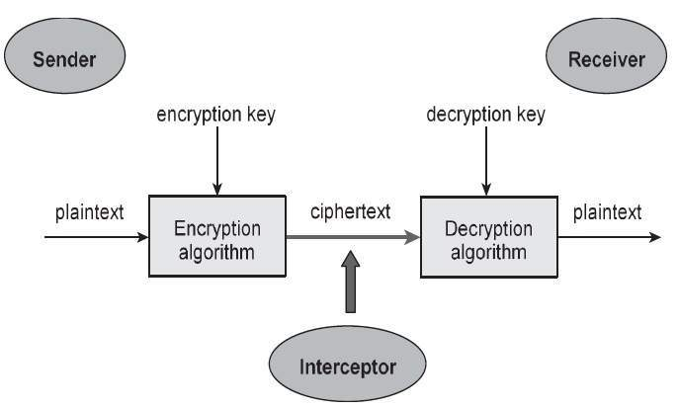
Introduction
What is Cryptography?
Cryptography is the practice and study of techniques for secure communication in the presence of adversarial behavior.
The main objective of cryptography is to construct and analyze protocols that prevent third parties or the public from reading private messages.

Slide 4
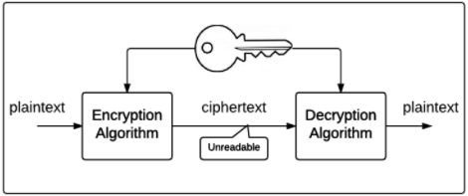
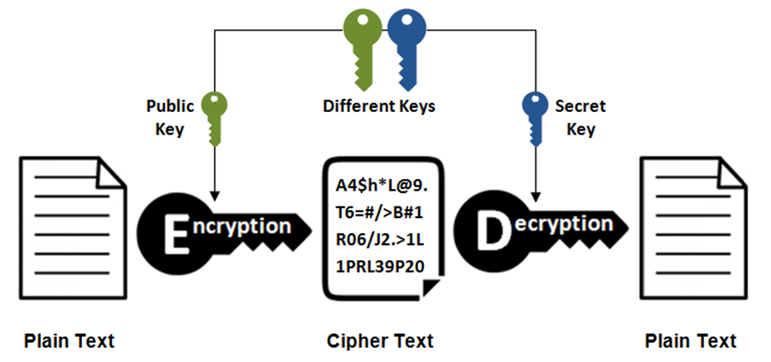
Types of Cryptography
Cryptosystems can be classified into two broad classes:
Symmetric Key Cryptosystems : uses same shared key for encryption and decryption
Asymmetric Key Cryptosystems : uses different keys for encryption and decryption

Slide 5
Symmetric Key Cryptography
Symmetric Key Cryptography also known as Symmetric Encryption is when a secret cryptographic key is leveraged for BOTH encryption and decryption functions.
The keys may be completely identical, or there may be a simple transformation to go between the two keys.
Types of Symmetric Key Cryptography
Stream Cipher
Block Cipher

Slide 6
Stream Cipher
Used to encrypt digits or letters of a message one at a time (Eg. one-time-pad RC4, A5/1) (Key length variable)
A simple demonstration of stream cipher (one-time-pad)
Let's say a message is in binary format and is to be transmitted securely. The Tx and the Rx have decided on a key of 10110 for this one message.
This key is usually decided at random to heighten security.
Lets say the message to be sent is 01101. To encrypt the message, a new cipher text is created by XORing the plain text with the key.
01101⊕10110=11011 ( cipher text)
To decrypt plain text from cipher text, the same cipher text is again XORed with the same key
11011⊕10110=01101 (plain text)

Slide 7
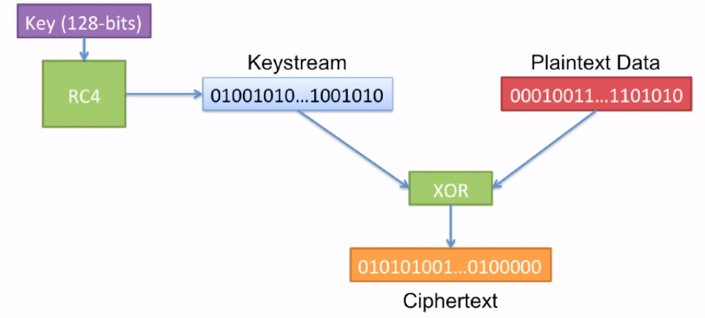
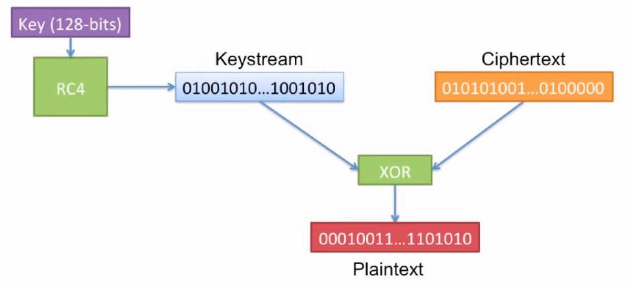
Stream Cipher Encryption and Decryption
Encryption
Decryption

Slide 8
Block Cipher
Takes a fixed number of bits (block) and encrypts them as a single unit. If the plaintext size is not the same as the fixed block size, padding is done so that it becomes a multiple of the block size.
Key length is fixed in case of block ciphers (For example: Block length = 64 bit, Key length = 128 bit)
Examples:
Data Encryption Standard (DES) {Block size = 64 bit, Key size = 56 bit}
Advanced Encryption Standard (AES) {Block size = 128 bit, Key size = 128/192/256 bits}

Slide 9
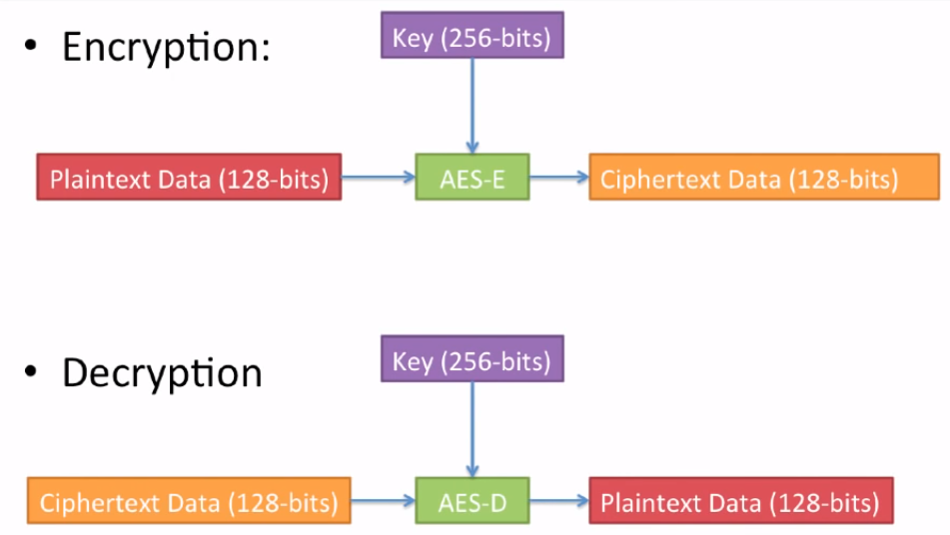
Simplified AES Example

Slide 10
Properties of Block Ciphers
Plaintext to CT mappings must be 1-to-1 for a given
This means the same PT always becomes the same CT (and vice-versa)
Input and output should have no correlation
Change 1-bit of the input block, the change on the output should not be distinguishable from random. (About 50% of output bits should change for 1 bit change in input)
Block size
Bigger is more secure, but probably slower.
Key size
Bigger is more secure, but probably slower.
Features of Block Ciphers

Slide 11
Advanced Encryption Standard (AES)
AES is a block cipher.
The key size can be 128/192/256 bits.
Encrypts data in blocks of 128 bits each.
AES performs operations on bytes of data rather than in bits. Since the block size is 128 bits, the cipher processes 128 bits (or 16 bytes) of the input data at a time.
The number of rounds depends on the key length
Key Length | Number of Rounds
128 bits | 10
192 bits | 12
256 bits | 14

Slide 12
AES encryption algorithm
AES considers each block as a 16 byte (4 byte x 4 byte = 128 ) grid in a column major arrangement.
This is matrix obtained after XORing the 128 bit plaintext with the Key generated.
A₀ | A₄ | A₈ | A₁₂
A₁ | A₅ | A₉ | A₁₃
A₂ | A₆ | A₁₀ | A₁₄
A₃ | A₇ | A₁₁ | A₁₅

Slide 13
Structure of each Round
Each round is layered into the following steps:
SubBytes – introduces confusion
ShiftRows
MixColumns
Add Round Key
The last round doesn’t have the MixColumns layer.
} -
Introduces diffusion through permutation

Slide 14
SubBytes
In this step each byte is substituted by another byte.
Its performed using a lookup table also called the S-box.
This substitution is done in a way that a byte is never substituted by itself and also not substituted by another byte which is a compliment of the current byte.
The result of this step is a 16 byte (4 x 4 ) matrix like before. B_{i} = S(A_{i})
B₀ | B₄ | B₈ | B₁₂
B₁ | B₅ | B₉ | B₁₃
B₂ | B₆ | B₁₀ | B₁₄
B₃ | B₇ | B₁₁ | B₁₅

Slide 15
ShiftRows
Each row is shifted a particular number of times.
The first row is not shifted
The second row is shifted once to the left. (left circular shift)
The third row is shifted twice to the left. (left circular shift)
The fourth row is shifted thrice to the left. (in effect a right circular shift)
B₀ | B₄ | B₈ | B₁₂
B₅ | B₉ | B₁₃ | B₁
B₁₀ | B₁₄ | B₂ | B₆
B₁₅ | B₃ | B₇ | B₁₁

Slide 16
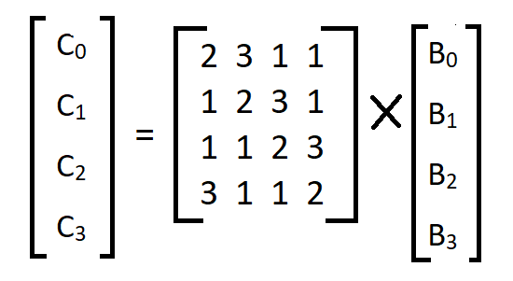
MixColumns
Each column is multiplied with a specific matrix and thus the position of each byte in the column is changed as a result.
Matrix to be used for multiplication:
Thus the resultant column following Matrix multiplication:
2 | 3 | 1 | 1
1 | 2 | 3 | 1
1 | 1 | 2 | 3
3 | 1 | 1 | 2

Slide 17
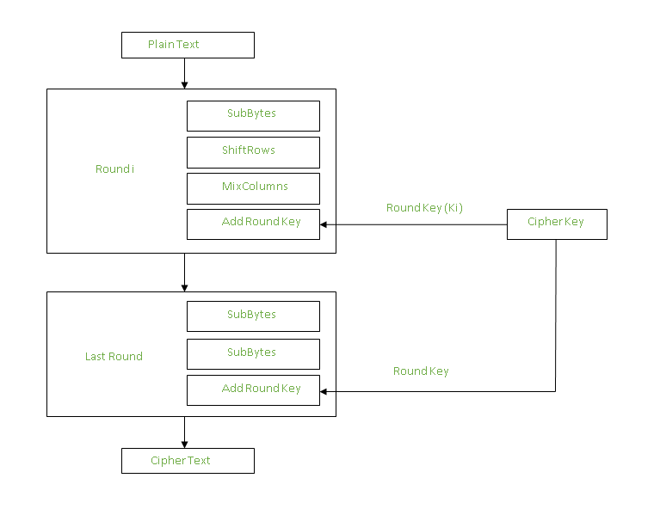
Add Round Keys
The resultant output of the previous stage is XOR-ed with the corresponding round key. Here, the 16 bytes is not considered as a grid but just as 128 bits of data.
After all these rounds 128 bits of encrypted data is given back as output.
This process is repeated until all the data to be encrypted undergoes this process.

Slide 18
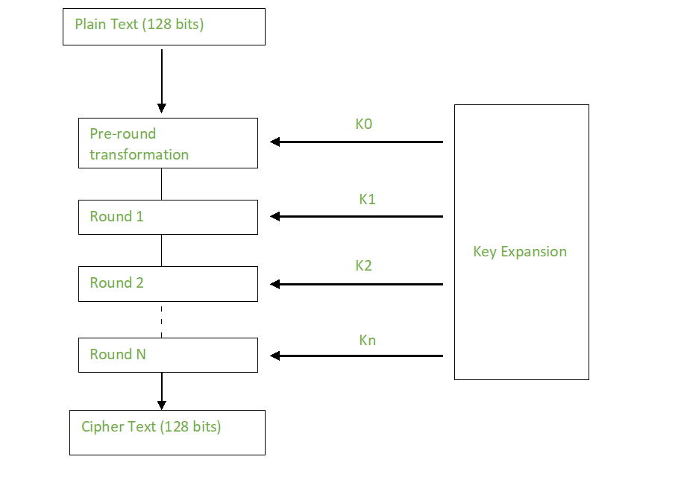
Creation of Round keys
A Key Schedule algorithm is used to calculate all the round keys from the key. So the initial key is used to create many different round keys which will be used in the corresponding round of the encryption.

Slide 19
AES Decryption
The stages of each round in decryption is as follows :
Add round key
Inverse MixColumns
ShiftRows
Inverse SubByte
Let the encrypted cipher after initial round key addition be denoted in byte form by the table shown:
C₀ | C₄ | C₈ | C₁₂
C₅ | C₉ | C₁₃ | C₁
C₁₀ | C₁₄ | C₂ | C₆
C₁₅ | C₃ | C₇ | C₁₁

Slide 20
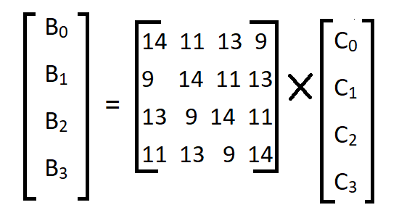
Inverse MixColumns
This step is similar to the MixColumns step in encryption, but differs in the matrix used to carry out the operation.
Inverse S-box is used as a lookup table and using which the bytes are substituted during decryption.
Inverse SubBytes

Slide 21
AES Summary
AES instruction set is now integrated into the CPU (offers throughput of several GB/s)to improve the speed and security of applications that use AES for encryption and decryption.
Even though its been 20 years since its introduction we have failed to break the AES algorithm as it is infeasible even with the current technology.
Till date the only vulnerability remains in the implementation of the algorithm.

Slide 22
Asymmetric key Cryptography
This type of encryption uses two separate keys for encryption and decryption — a public key and a private key.
A public key is a cryptographic key that can be used by any person to encrypt a message so that it can only be decrypted by the intended recipient with their private key.
A private key -- also known as a secret key -- is shared only with key's initiator.
Many protocols rely on asymmetric cryptography, including the transport layer security (TLS) and secure sockets layer (SSL) protocols, which make HTTPS possible.
Increased data security is the primary benefit of asymmetric cryptography. It is the most secure encryption process because users are never required to reveal or share their private keys, thus decreasing the chances of a cybercriminal discovering a user's private key during transmission.

Slide 23
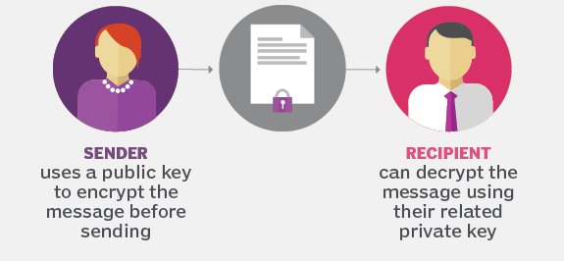
How does asymmetric cryptography work?
Asymmetric encryption uses a mathematically related pair of keys for encryption and decryption: a public key and a private key.
If the public key is used for encryption, then the related private key is used for decryption. If the private key is used for encryption, then the related public key is used for decryption.
The sender obtains the receiver's public key. Next, the plaintext message is encrypted by the sender using the receiver's public key. This creates ciphertext. The ciphertext is sent to the receiver, who decrypts it with their private key, returning it to legible plaintext.
Because of the one-way nature of the encryption function, one sender is unable to read the messages of another sender, even though each has the public key of the receiver.

Slide 24
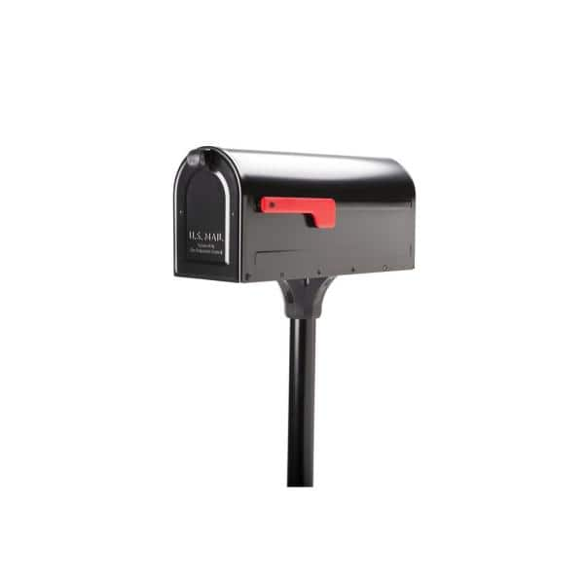

A simple mailbox analogy
The location of a persons mailbox is publicly known (public key), people can send their messages by addressing through the public key.
However, the letters can only be accessed and read by the owner using his/her private key to open the mailbox.
Key to open the mailbox: Private Key
Location of mailbox: Public Key

Slide 25
Uses of asymmetric cryptography
To authenticate data using digital signatures. A digital signature is a mathematical technique used to validate the authenticity and integrity of a message, software or digital document. It is the digital equivalent of a handwritten signature or stamped seal.
Applied to systems in which many users may need to encrypt and decrypt messages, including:
Encrypted email. A public key can be used to encrypt a message and a private key can be used to decrypt it.
SSL/TLS. Establishing encrypted links between websites and browsers also makes use of asymmetric encryption.
Cryptocurrencies. Bitcoin and other cryptocurrencies rely on asymmetric cryptography.

Slide 26
Advantages of Asymmetric Cryptography
The key distribution problem is eliminated because there's no need for exchanging keys.
Security is increased since the private keys don't ever have to be transmitted or revealed to anyone.
The use of digital signatures is enabled so that a recipient can verify that a message comes from a particular sender.
It allows for nonrepudiation so the sender can't deny sending a message.

Slide 27
Disadvantages of Asymmetric Cryptography
It's a slow process compared to symmetric cryptography. Therefore, it's not appropriate for decrypting bulk messages.
If an individual loses his private key, he can't decrypt the messages he receives.
Because public keys aren't authenticated, no one can ensure a public key belongs to the person specified. Consequently, users must verify that their public keys belong to them.
If a malicious actor identifies a person's private key, the attacker can read that individual's messages.
The difference in the length of the keys is very pronounced, a 2048-bit asymmetric key and a 128-bit symmetric key provide about an equivalent level of security.

Slide 28
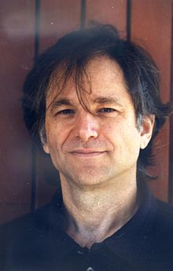
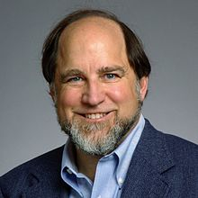

Rivest–Shamir–Adleman (RSA)
RSA algorithm is asymmetric cryptography algorithm.
The idea of RSA is based on the fact that it is difficult to factorize a large integer.
The public key consists of two numbers where one number is multiplication of two large prime numbers.
Private key is also derived from the same two prime numbers.
If somebody can factorize the large number, the private key is compromised. Therefore encryption strength totally lies on the key size and if we double or triple the key size, the strength of encryption increases exponentially.
RSA keys can be typically 1024 or 2048 bits long
Ron Rivest Adi Shamir Leonard Adleman

Slide 29
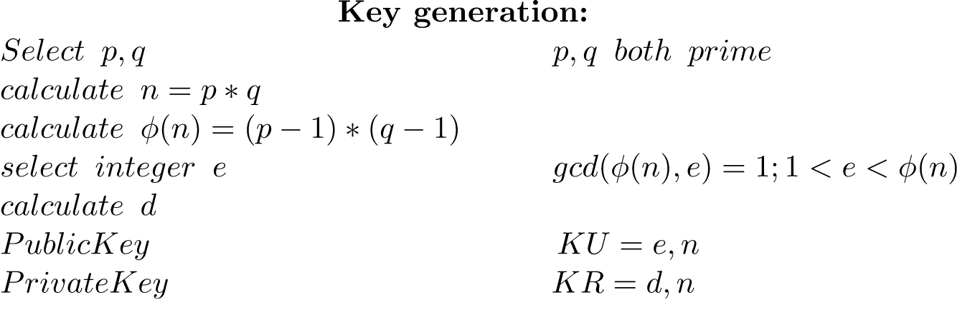
Mechanism behind RSA algorithm
Key generation is based on the product of two large prime numbers p and q resulting into N i.e. N = p × q.
The attacker needs to first find out p and q by factorization of N which takes place in exponential time.

Slide 30

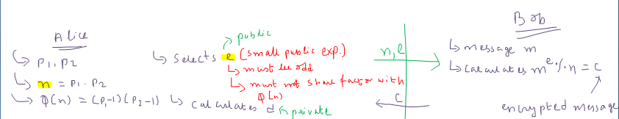

Slide 31
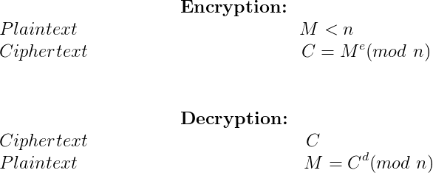
Mechanism behind RSA algorithm

Slide 32
Mechanism behind RSA algorithm
If p=53, q=59 Public Key ( n = 3127 and e = 3) and Private Key(d = 2011)
Encrypting message “HI”:
Convert letters to numbers :
H = 8 and I = 9
Thus Encrypted Data c = 89e mod n. Thus our Encrypted Data comes out to be 1394 Now we will decrypt 1394 :
Decrypted Data = c^{d} mod n.
Thus our Encrypted Data comes out to be 89. 8 = H and I = 9 i.e. "HI".
For efficiency, many popular crypto libraries use for decryption and signing the optimization based on the Chinese remainder theorem.
A good video demonstration of RSA algorithm at work: https://www.youtube.com/watch?v=wXB-V_Keiu8

Slide 33


Hash Function
A cryptographic hash (sometimes called ‘digest’) is a kind of ‘signature’ for a text or a data file.
A hash is not ‘encryption’ – it cannot be decrypted back to the original text (it is a ‘one-way’ cryptographic function, and is a fixed size for any size of source text). This makes it suitable when it is appropriate to compare ‘hashed’ versions of texts, as opposed to decrypting the text to obtain the original version.
Input: Arbitrary Length
Hash function
Output: Fixed Length

Slide 34
Applications of Hash Function
anti-tamper – link a hash of a message to the original, and the recipient can re-hash the message and compare it to the supplied hash: if they match, the message is unchanged; this can also be used to confirm no data-loss in transmission
‘challenge handshake authentication’ (or ‘challenge hash authentication’) avoids transmissing passwords in ‘clear’ – a client can send the hash of a password over the internet for validation by a server without risk of the original password being intercepted
digital signatures are rather more involved, but in essence, you can sign the hash of a document by encrypting it with your private key, producing a digital signature for the document. Anyone else can then check that you authenticated the text by decrypting the signature with your public key to obtain the original hash again, and comparing it with their hash of the text.

Slide 35
Secure Hash Algorithm : SHA-256
SHA-256 is one of the successor hash functions to SHA-1 (collectively referred to as SHA-2), and is one of the strongest hash functions available. SHA-256 is not much more complex to code than SHA-1, and has not yet been compromised in any way.
Properties of SHA-256:
Preimage attack resistant: Seeing the hash code, we will not be able to predict the characteristics of the item hashed
Collision resistant: There is negligible probability that two words have the same hash code (1 in 2^256)
The 256-bit key makes it a good partner-function for AES.

Slide 36
Steps in SHA-256 algorithm
Step 1: Preprocessing
Convert the given data to binary
Append a single 1 at the end
Pad with 0’s until data is 64 bits less than a multiple of 512
Append 64 bits to the end, where the 64 bits are a big-endian integer representing the length of the original input in binary.
Now we have our input, which will always be evenly divisible by 512.
Step 2 – Initialize Hash Values (h)
We create 8 hash values. These are hard-coded constants that represent the first 32 bits of the fractional parts of the square roots of the first 8 primes. (h0-h7)

Slide 37
Steps in SHA-256 algorithm
Step 3: Initialize Round Constants (k)
Similar to step 2, we create some constants.
There are 64 of them. Each value (0-63) is the first 32 bits of the fractional parts of the cube roots of the first 64 primes
Step 4 – Chunk Loop
The following steps will happen for each 512-bit “chunk” of data from our input. At each iteration of the loop, we will be mutating the hash values h0-h7, which will be the final output.

Slide 38
Steps in SHA-256 algorithm
Step 5 – Create Message Schedule (w)
Copy the input data from step 1 into a new array where each entry is a 32-bit word
Add 48 more words initialized to zero, such that we have an array w[0…63]
Modify the zero-ed indexes at the end of the array using the following algorithm:
For i from w[16…63]:
s0 = (w[i-15] rightrotate 7) xor (w[i-15] rightrotate 18) xor (w[i-15] rightshift 3)
s1 = (w[i- 2] rightrotate 17) xor (w[i- 2] rightrotate 19) xor (w[i- 2] rightshift 10)
w[i] = w[i-16] + s0 + w[i-7] + s1
This leaves us with 64 words in our message schedule (w)

Slide 39
Steps in SHA-256 algorithm
Step 6 – Compression
Initialize variables a, b, c, d, e, f, g, h and set them equal to the current hash values respectively. h0, h1, h2, h3, h4, h5, h6, h7
Run the compression loop. The compression loop will mutate the values of a…h. The compression loop is as follows:
for i from 0 to 63
S1 = (e rightrotate 6) xor (e rightrotate 11) xor (e rightrotate 25)
ch = (e and f) xor ((not e) and g)
temp1 = h + S1 + ch + k[i] + w[i]
S0 = (a rightrotate 2) xor (a rightrotate 13) xor (a rightrotate 22)
maj = (a and b) xor (a and c) xor (b and c)
temp2 := S0 + maj
h = g
g = f
f = e
e = d + temp1
d = c
c = b
b = a
a = temp1 + temp2

Slide 40
Steps in SHA-256 algorithm
Step 7 – Modify Final Values
After the compression loop, but still, within the chunk loop, we modify the hash values by adding their respective variables to them, a-h. As usual, all addition is modulo 2^32.
Step 8 – Concatenate Final Hash
Last but not least, join them all together, using a simple string concatenation will do.

Slide 41
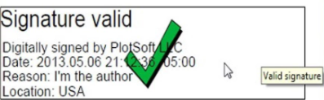
What is Digital Signature?
A digital signature is a code attached to a message or a document. Verifying the code proves that the message was unchanged or it was not tampered with. One should not confuse it with a digital signature certificate, which is equivalent to paper certificates that validate the holder’s identity.
Digital signatures have been developed as an application of cryptography and also find extensive utility in network security.
Digital signatures are easy to use & essentially involve the convenient click of a button. However, behind this simple process of clicking and selecting a signature source, is a complex workflow involving multiple instances of encryption and decryption.

Slide 42
How are digital signatures created?
A digital signature is created using hash algorithms or a scheme of algorithms like Digital Signature Algorithm (DSA) or RSA that use public key and private key encryptions. The sender uses the private key to sign the message digest (not the data), and when they do, it forms a digital thumbprint to send the data.
When a signed document is authenticated using the public key, the signer is aware of who created it & whether the document has been altered since being digitally signed. The decryption process gets back the original hashed document, and this can be compared to the encrypted hash, to determine the authenticity of the document & the digital signature.
To verify the identity of the signer and the digital signature, DSC or Digital Signature Certificate is issued. DSC is a secure digital public key that does all the decrypting & authenticates the identity of the holder. To understand what DSC is and why you require it, we’ll delve into the details further in this article.

Slide 43
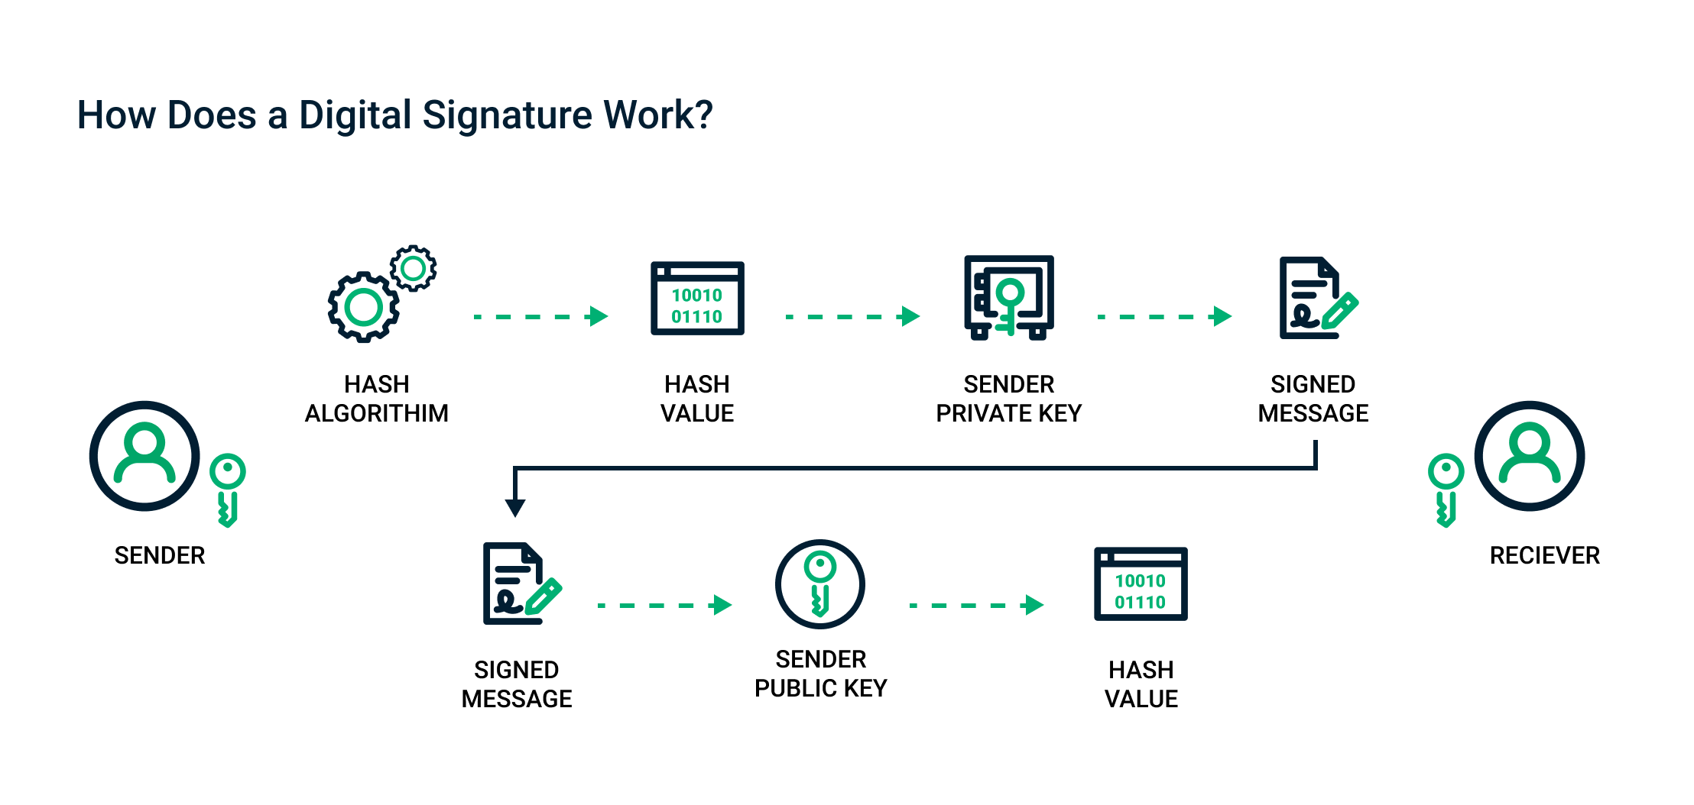

Slide 44
References
Symmetric Encryption and AES:
https://brilliant.org/wiki/symmetric-ciphers/
https://www.youtube.com/watch?v=O4xNJsjtN6E&t=300s
https://www.geeksforgeeks.org/advanced-encryption-standard-aes/amp/
https://en.wikipedia.org/wiki/Advanced_Encryption_Standard
https://www.movable-type.co.uk/scripts/aes.html
Asymmetric Encryption and RSA:
https://www.youtube.com/watch?v=wXB-V_Keiu8
https://www.techtarget.com/searchsecurity/definition/asymmetric-cryptography
https://sectigostore.com/blog/what-is-asymmetric-encryption-how-does-it-work/
https://www.geeksforgeeks.org/rsa-algorithm-cryptography/
https://en.wikipedia.org/wiki/RSA_(cryptosystem)
Hashing and SHA
https://qvault.io/cryptography/how-sha-2-works-step-by-step-sha-256/
https://en.wikipedia.org/wiki/Hash_function
https://www.tutorialspoint.com/cryptography/cryptography_hash_functions.htm
Digital Signature: link

Slide 45
Thank You

